Slide 1
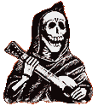
Aim: What impact did the Black Plague have on society?
The Black Death
1347 - 1351

Slide 2
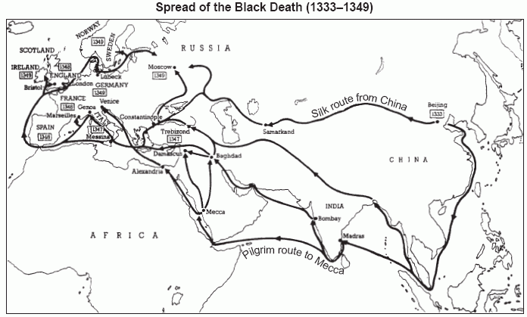
Why did the Black Death spread so quickly throughout Europe?

Slide 3
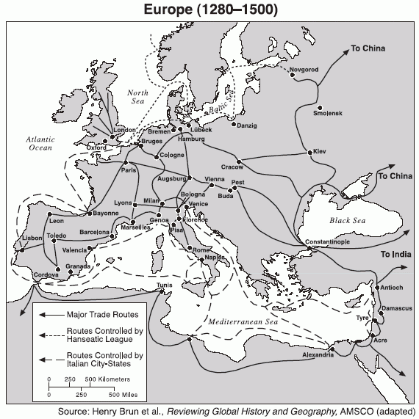

Slide 4
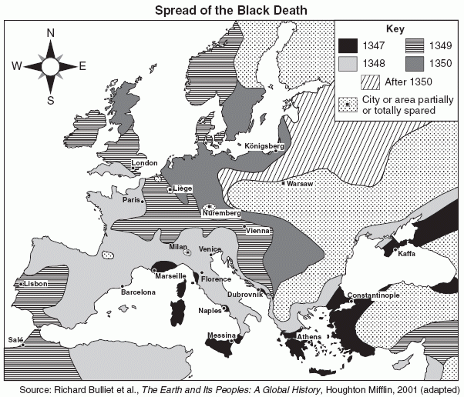
How could the European governments have contained the Black plague?

Slide 5
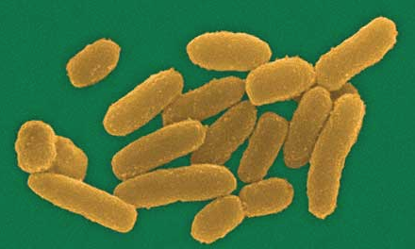
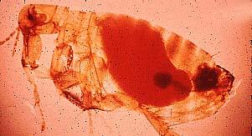
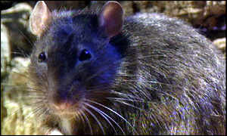
The Culprits

Slide 6
The Signs of Impending Death
"The symptoms were not the same as in the East, where a gush of blood from the nose was the plain sign of inevitable death; but it began both in men and women with certain swellings in the groin or under the armpit. They grew to the size of a small apple or an egg, more or less, and were vulgarly called tumours. In a short space of time these tumours spread from the two parts named all over the body. Soon after this the symptoms changed and black or purple spots appeared on the arms or thighs or any other part of the body, sometimes a few large ones, sometimes many little ones. These spots were a certain sign of death, just as the original tumour had been and still remained. No doctor's advice, no medicine could overcome or alleviate this disease, An enormous number of ignorant men and women set up as doctors in addition to those who were trained. Either the disease was such that no treatment was possible or the doctors were so ignorant that they did not know what caused it, and consequently could not administer the proper remedy. In any case very few recovered; most people died within about three days of the appearance of the tumours described above, most of them without any fever or other symptoms.
The violence of this disease was such that the sick communicated it to the healthy who came near them, just as a fire catches anything dry or oily near it. And it even went further. To speak to or go near the sick brought infection and a common death to the living; and moreover, to touch the clothes or anything else the sick had touched or worn gave the disease to the person touching. "

Slide 7
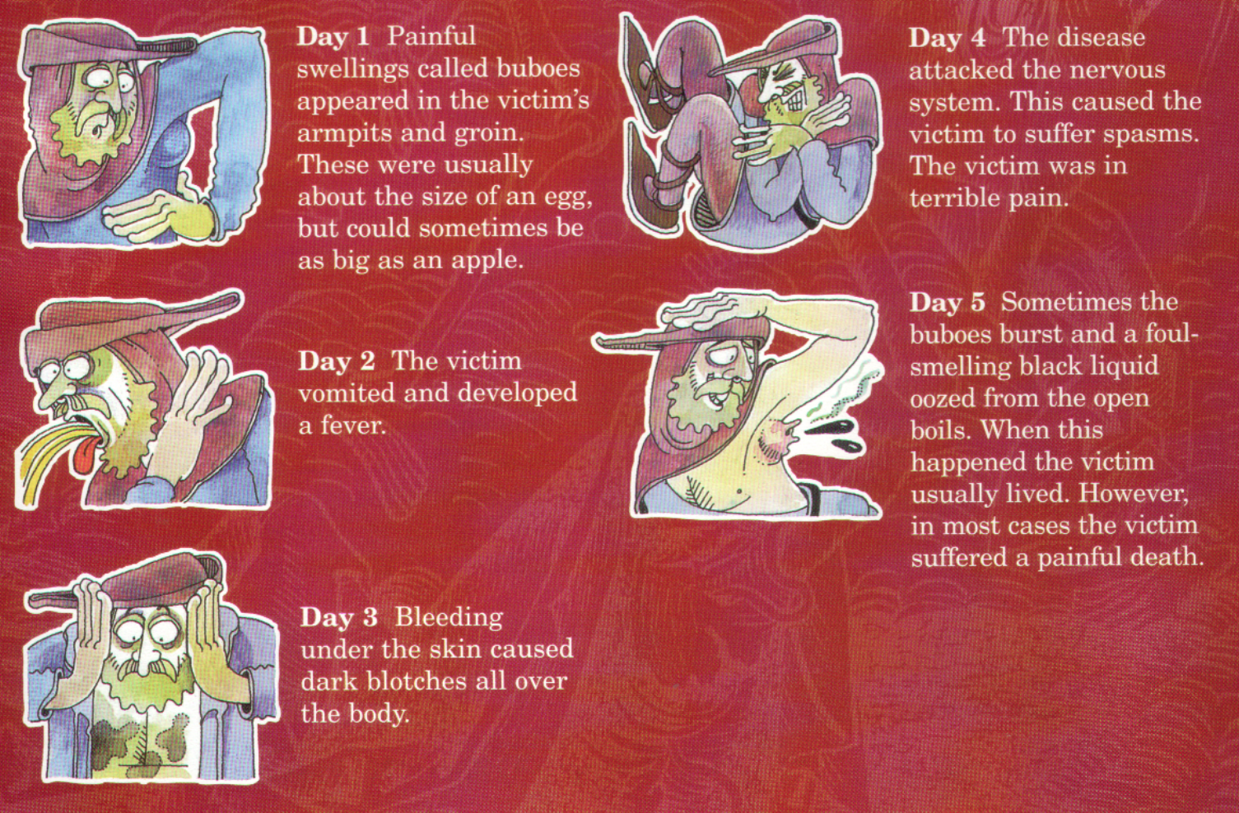
What were the symptoms of the plague?

Slide 8
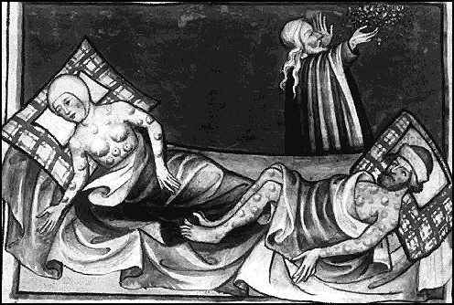
From the Toggenburg Bible, 1411

Slide 9
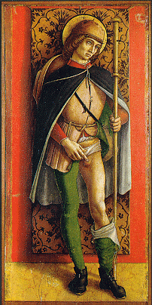
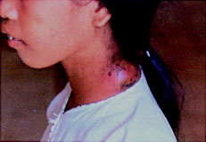
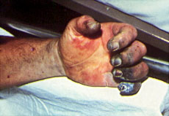
The Symptoms
Bulbous
Septicemia Form: almost 100% mortality rate.

Slide 10
The Disease Cycle
Flea drinks rat blood that carries the bacteria.
Bacteria
multiply in
flea’s gut.
Human is infected!
Flea bites human and regurgitates blood into human wound.
Flea’s gut clogged with bacteria.

Slide 11
Boccaccio in The Decameron
“The victims ate lunch with their friends and dinner with their ancestors.”

Slide 12
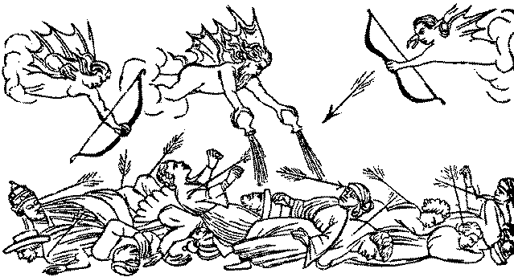
Medieval Art & the Plague

Slide 13
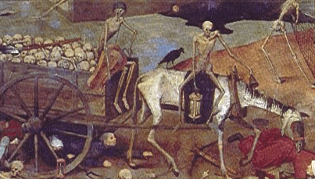
Medieval Art & the Plague
Bring out your dead!

Slide 14
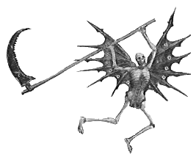
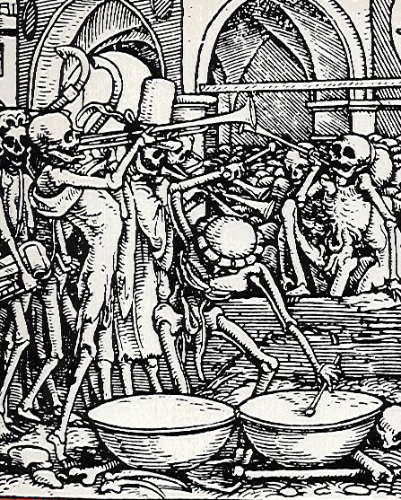

Medieval Art & the Plague
An obsession with death.

Slide 15
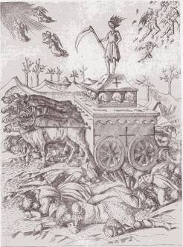
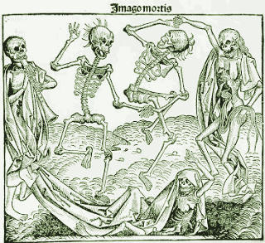
Medieval Art & the Plague

Slide 16
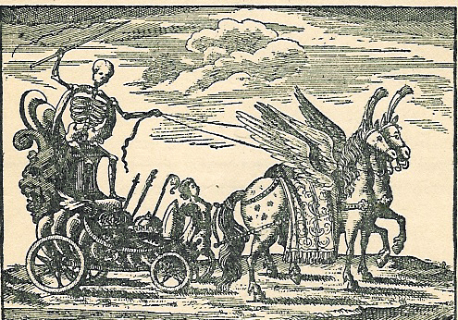
Death Triumphant !: A Major Artistic Theme

Slide 17
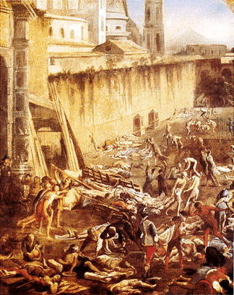
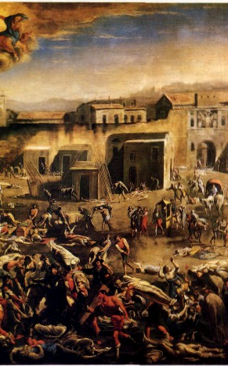
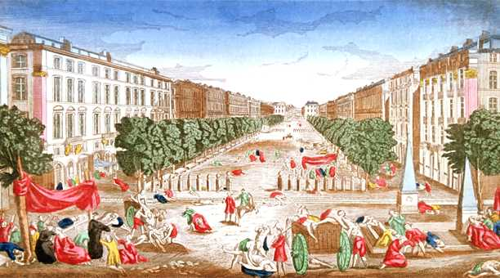
What do you think these pictures are indicating?

Slide 18
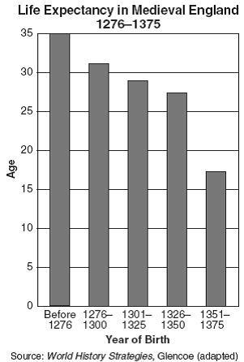
Life Expectancy
Why did the Life Expectancy decline in Medieval England?

Slide 19
Ring a-round the rosy Pocket full of posies Ashes, ashes! We all fall down!
Ring around the rosy: rosary beads give you God's help.
A pocket full of posies: used to stop the odor of rotting bodies which was at one point thought to cause the plague, it was also used widely by doctors to protect them from the infected plague patients.
Ashes, ashes: the church burned the dead when burying them became to laborious.
We all fall down: dead. Not only were the children effected physically, but also mentally.
Exposure to public nudity, craziness, and (obviously) abundant death was premature.
The decease of family members left the children facing death and pain at an early age.
Parents even abandoned their children, leaving them to the streets instead of risking the babies giving them the dreaded "pestilence". Children were especially unlucky if they were female.
Baby girls would be left to die because parents would favor male children that could carry on the family name.

Slide 20
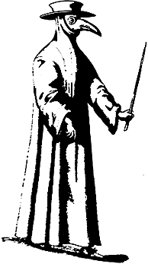
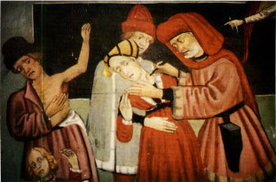
Attempts to Stop the Plague
“Leeching”
A Doctor’s Robe

Slide 21
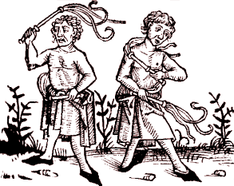
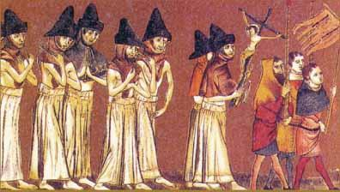
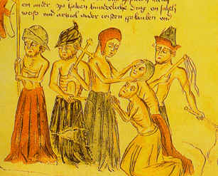
Attempts to Stop the Plague
Flagellanti: Self-inflicted “penance” for our sins!

Slide 22
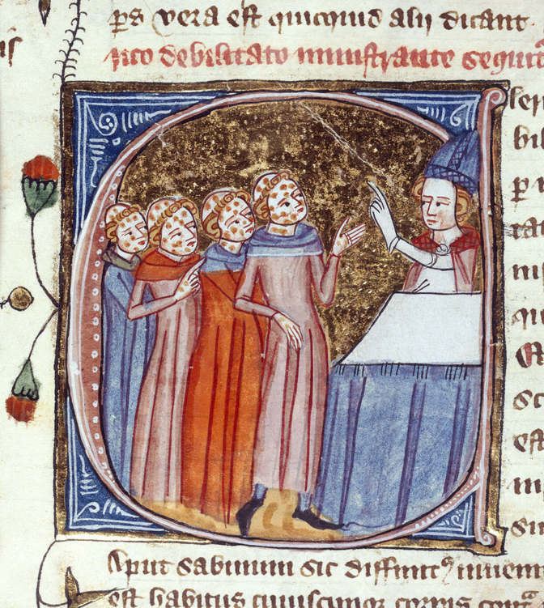
Monks, disfigured by the plague, being blessed by a priest. England, 1360Monks, disfigured by the plague, being blessed by a priest. England, 1360–75.

Slide 23
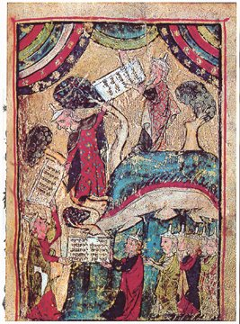
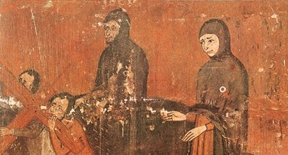
Attempts to Stop the Plague
Pograms against the Jews
“Golden Circle” obligatory badge
“Jew” hat

Slide 24
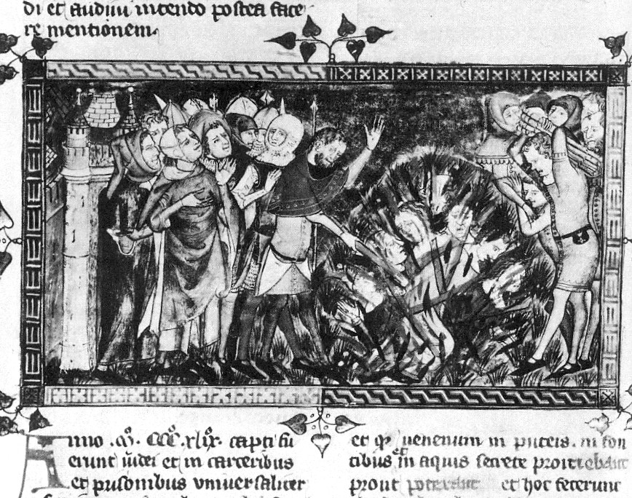
Persecution
The burning of Jews in 1349 (from a European chronicle written on the Black Death between 1349 and 1352)

Slide 25
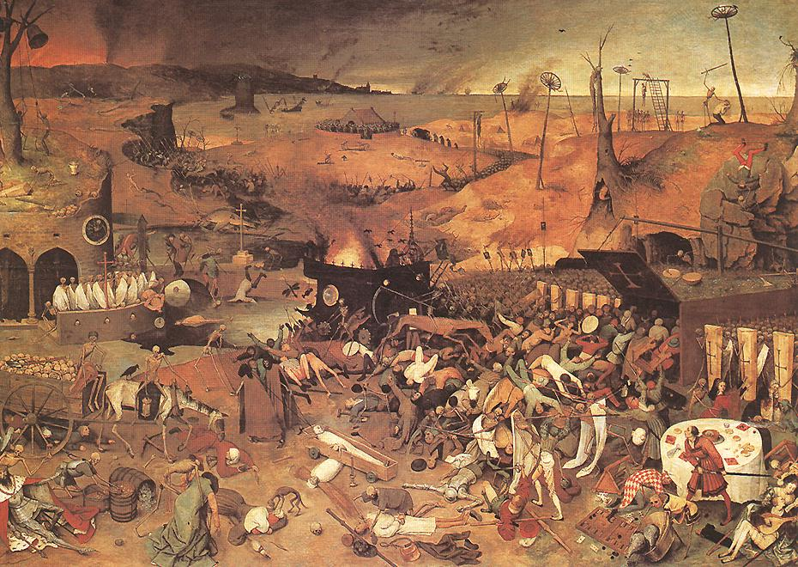

Slide 26
A Little Macabre Ditty
“A sickly season,” the merchant said, “The town I left was filled with dead, and everywhere these queer red flies crawled upon the corpses’ eyes, eating them away.” “Fair make you sick,” the merchant said, “They crawled upon the wine and bread. Pale priests with oil and books, bulging eyes and crazy looks, dropping like the flies.”

Slide 27
A Little Macabre Ditty (2)
“I had to laugh,” the merchant said, “The doctors purged, and dosed, and bled; “And proved through solemn disputation “The cause lay in some constellation. “Then they began to die.” “First they sneezed,” the merchant said, “And then they turned the brightest red, Begged for water, then fell back. With bulging eyes and face turned black, they waited for the flies.”

Slide 28
A Little Macabre Ditty (3)
“I came away,” the merchant said, “You can’t do business with the dead. “So I’ve come here to ply my trade. “You’ll find this to be a fine brocade…”
And then he sneezed……….!

Slide 29
The Mortality Rate
35% - 70%
25,000,000 dead !!!

Slide 30
What were the political, economic, and social effects of the Black Death??

Slide 31
"Neither physicians nor medicines were effective. Whether because these illnesses were previously unknown or because physicians had not previously studied them, there seemed to be no cure. There was such a fear that no one seemed to know what to do. When it took hold in a house it often happened that no one remained who had not died. And it was not just that men and women died, but even sentient animals died. Dogs, cats, chickens, oxen, donkeys sheep showed the same symptoms and died of the same disease. And almost none, or very few, who showed these symptoms, were cured. The symptoms were the following: a bubo in the groin, where the thigh meets the trunk; or a small swelling under the armpit; sudden fever; spitting blood and saliva (and no one who spit blood survived it). It was such a frightful thing that when it got into a house, as was said, no one remained. Frightened people abandoned the house and fled to another."
-Marchione di Coppo Stefani

Slide 32
"Realizing what a deadly disaster had come to them the people quickly drove the Italians from their city. However, the disease remained, and soon death was every where. Fathers abandoned their sick sons. Lawyers refused to come and make out wills for the dying. Friars and nuns were left to care for the sick, and monasteries and convents were soon deserted, as they were stricken, too. Bodies were left in empty houses, and there was no one to give them a Christian burial."
-Unknown

Slide 33
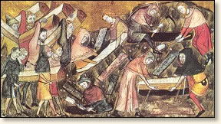
"The plight of the lower and most of the middle classes was even more pitiful to behold. Most of them remained in their houses, either through poverty or in hopes of safety, and fell sick by thousands. Since they received no care and attention, almost all of them died. Many ended their lives in the streets both at night and during the day; and many others who died in their houses were only known to be dead because the neighbors smelled their decaying bodies. Dead bodies filled every corner. Most of them were treated in the same manner by the survivors, who were more concerned to get rid of their rotting bodies than moved by charity towards the dead. With the aid of porters, if they could get them, they carried the bodies out of the houses and laid them at the door; where every morning quantities of the dead might be seen. They then were laid on biers or, as these were often lacking, on tables.
Citizens of Tournai bury plague victims. These are fortunate to have coffins. Most victims were interred in mass graves.
Such was the multitude of corpses brought to the churches every day and almost every hour that there was not enough consecrated ground to give them burial, especially since they wanted to bury each person in the family grave, according to the old custom. Although the cemeteries were full they were forced to dig huge trenches, where they buried the bodies by hundreds. Here they stowed them away like bales in the hold of a ship and covered them with a little earth, until the whole trench was full."

Slide 34
"Brother abandoned brother"
"One citizen avoided another, hardly any neighbor troubled about others, relatives never or hardly ever visited each other. Moreover, such terror was struck into the hearts of men and women by this calamity, that brother abandoned brother, and the uncle his nephew, and the sister her brother, and very often the wife her husband. What is even worse and nearly incredible is that fathers and mothers refused to see and tend their children, as if they had not been theirs.
Thus, a multitude of sick men and women were left without any care, except from the charity of friends (but these were few), or the greed, of servants, though not many of these could be had even for high wages, Moreover, most of them were coarse-minded men and women, who did little more than bring the sick what they asked for or watch over them when they were dying. And very often these servants lost their lives and their earnings. Since the sick were thus abandoned by neighbors, relatives and friends, while servants were scarce, a habit sprang up which had never been heard of before. Beautiful and noble women, when they fell sick, did not scruple to take a young or old man-servant, whoever he might be, and with no sort of shame, expose every part of their bodies to these men as if they had been women, for they were compelled by the necessity of their sickness to do so. This, perhaps, was a cause of looser morals in those women who survived."

Slide 35
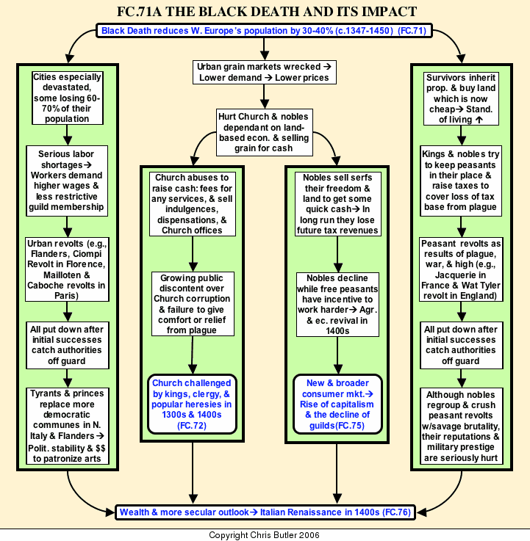

Slide 36
Effects of the Black Plague
Depopulation – 25 Million
Shortage of Labor
Redistribution of Wealth
Persecution – Minority – Jews
Social Breakdown – Panic, Fear, Abandon, Flee
Question authority of the Church and Religion
Renaissance, Scientific Revolution, Protestant Reformation, Age of Exploration

Slide 37
Discussion Question
A modern epidemic: AIDS. Today, huge numbers of people are infected with HIV virus and face certain death from AIDS.
-Compare and contrast conditions in these countries to conditions in medieval Europe.
-What parallels can be drawn between plague-stricken medieval villages and modern villages in central Africa, which have been devastated by the HIV virus?

Slide 38
Discussion Question
Population and the environment: Most environmental scientists agree that the continued growth of human population on Earth is not environmentally sustainable.
Do you think our planet would be able to heal its environmental wounds faster with fewer humans living on it?
Are epidemics of infectious disease nature's way of regulating population?
Can you think of more humane solutions to the problem of global overpopulation?

Slide 39
Discussion Question
Radical Depopulation: .
How would the United States be changed today if it experienced the death of 1/2 to 2/3 of its population?
Would there be a redistribution of wealth, as took place in late medieval times?
What role would religion play in modern times if a radical depopulation took place?

